Slide 1
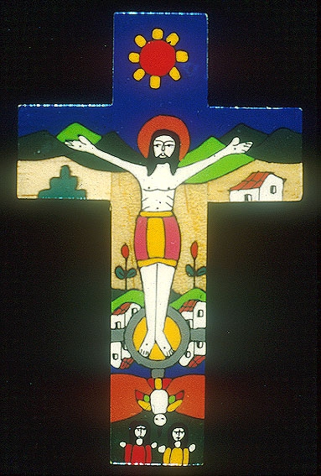
Stations Of The Cross

Slide 2
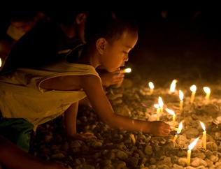
As we look at these pictures, we think of the journey that Jesus made to the place he was crucified, carrying his cross.

Slide 3
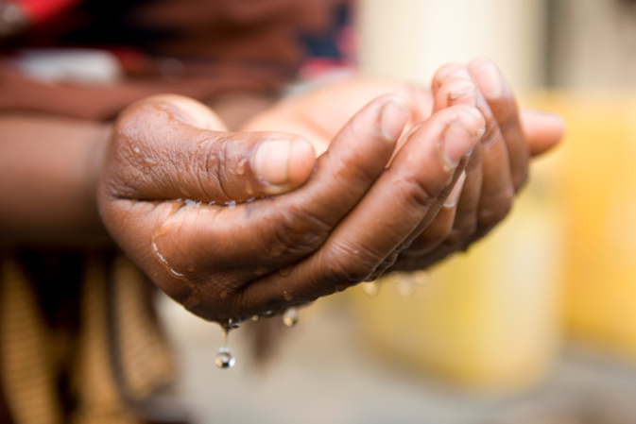
First Station: Jesus is condemned to Death.
Pontius Pilate was the governor of Judea at the time of Jesus death. Pilate did not want to kill Jesus. He washes his hands in a bowl to show that he didn’t want anything to do with it.

Slide 4
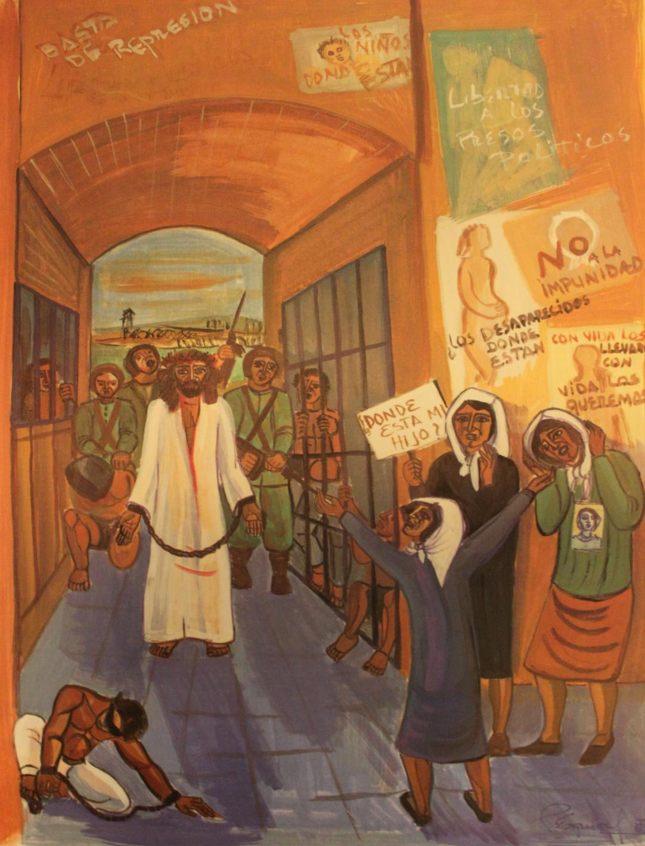
Give us courage to stand for the people who have no-one to stand up for them.

Slide 5
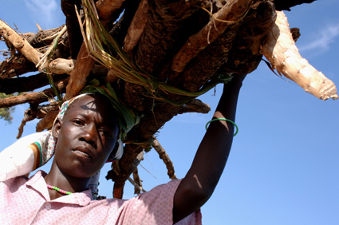
Second Station: Jesus takes up his Cross.
Jesus was made to carry his cross. He is wearing a crown of thorns. The soldiers made it for him because they thought he was the “King of the Jews”.

Slide 6
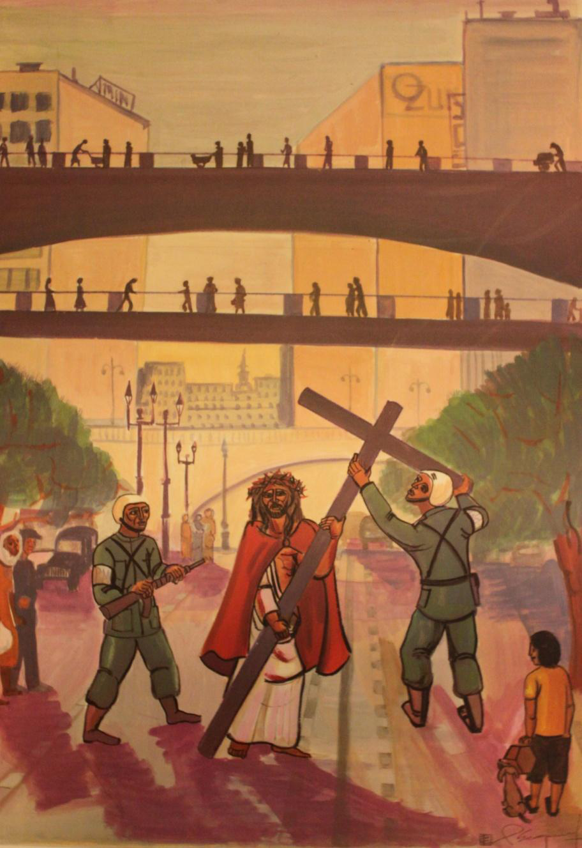
Jesus, we know that you felt pain and discomfort at this time. We ask you to help us with the burdens we have to carry.

Slide 7
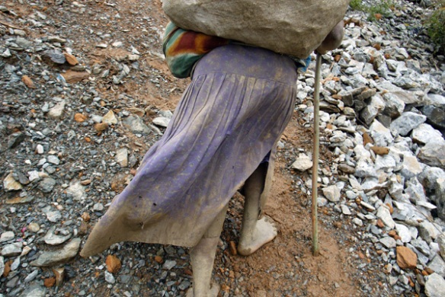
Third Station: Jesus falls for the First Time
Jesus was in a bad way, the soldiers had beaten him. He was weak and he fell.
Think about what the crowds might have shouted when he fell over.

Slide 8
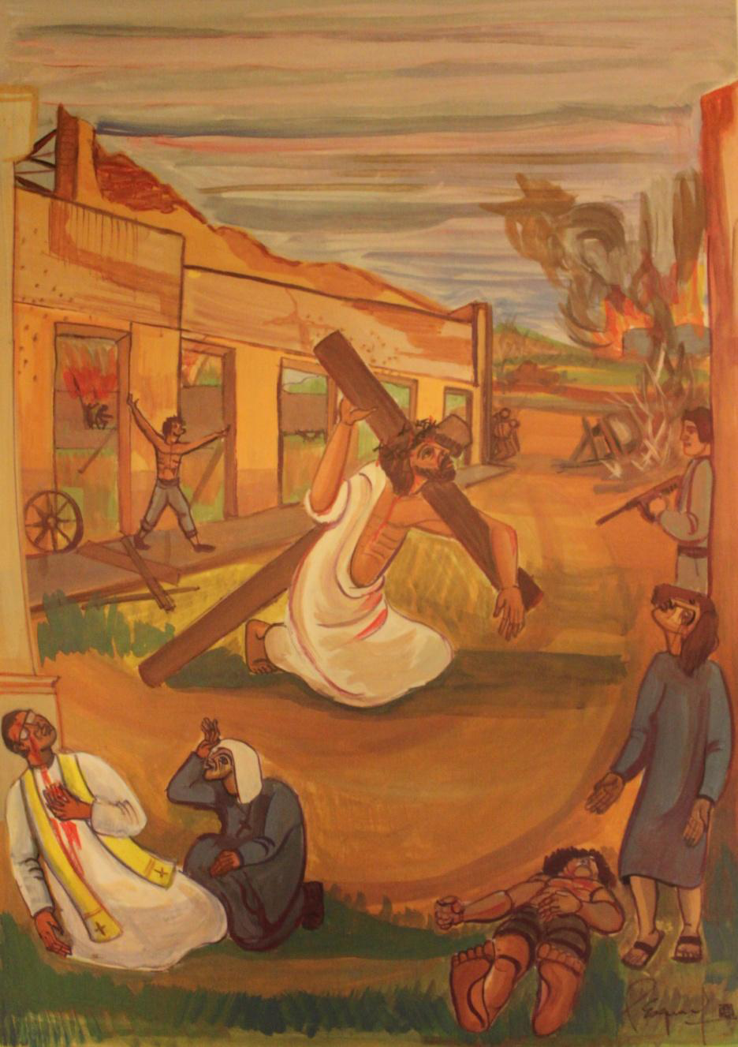
Lord Jesus, at this moment there was no-one to care for you. Many people live in our world without care and protection: the starving, the homeless and those living in terror. Be with them Lord in their times of trial and help us to do what we can to support them.

Slide 9
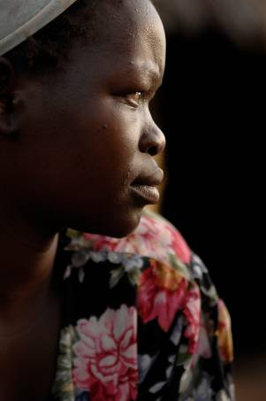
Fourth Station: Jesus meets his Mother.
We have all got very special people in our lives that we are really glad to see. This is a very sad meeting between Jesus and his mother, Mary.

Slide 10
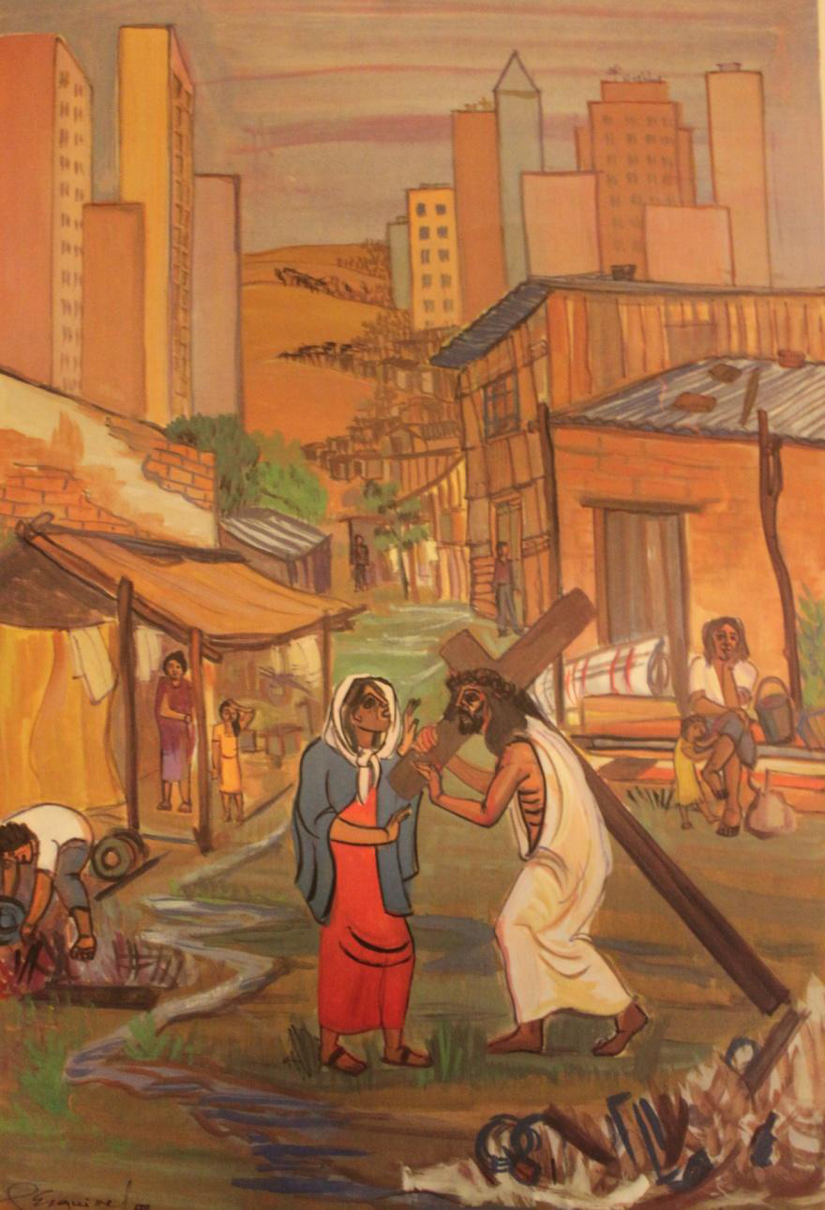
Lord Jesus, your mother loved you more than anybody else in the world. Be close to all our mothers.

Slide 11
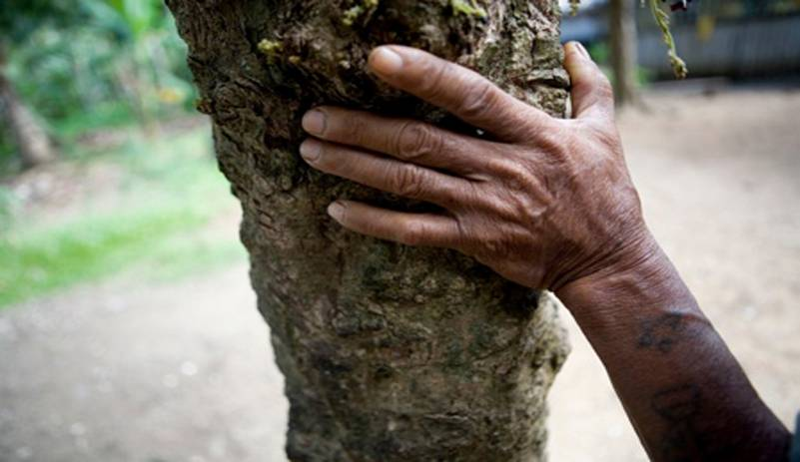
Fifth Station: Simon of Cyrene helps Jesus carry his cross.
Simon of Cyrene didn’t really want to help Jesus, but the Roman soldiers made him come and help. However, Simon soon realised that he was privileged to help Jesus.

Slide 12
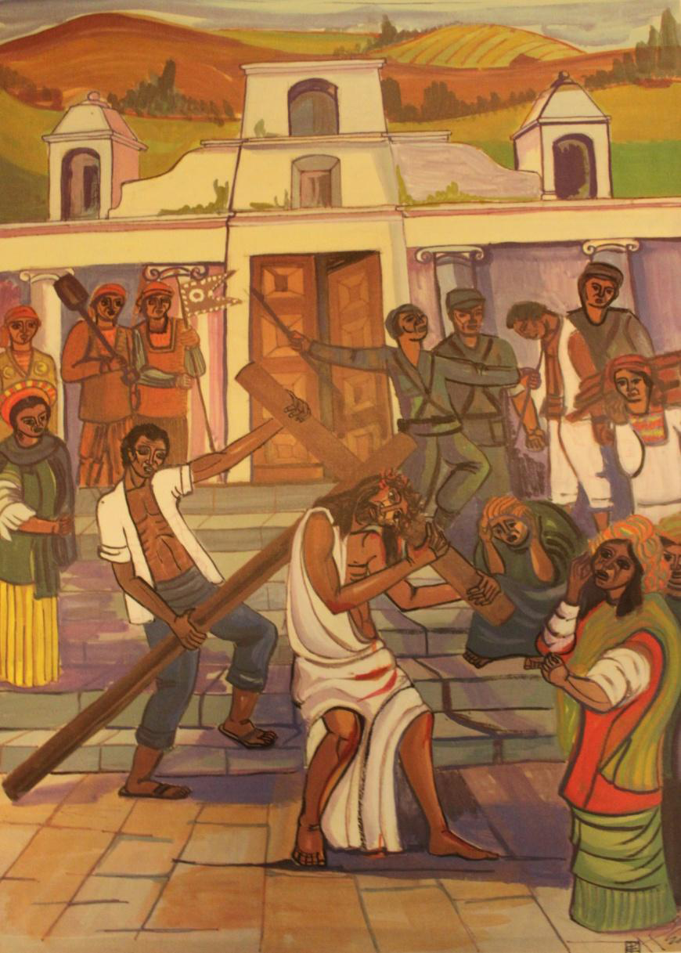
Lord, help us to be like Simon. There are so many people who suffer and need our help. Each day we have the chance to show somebody love and care. Help us never to miss these opportunities.

Slide 13
Sixth Station: Veronica wipes the face of Jesus.
Veronica was very brave, she fought her way through the crowd to wipe the face of Jesus. She felt sorry for Jesus. The story says that after she had wiped the face of Jesus, the image of his face appeared on her cloth.

Slide 14
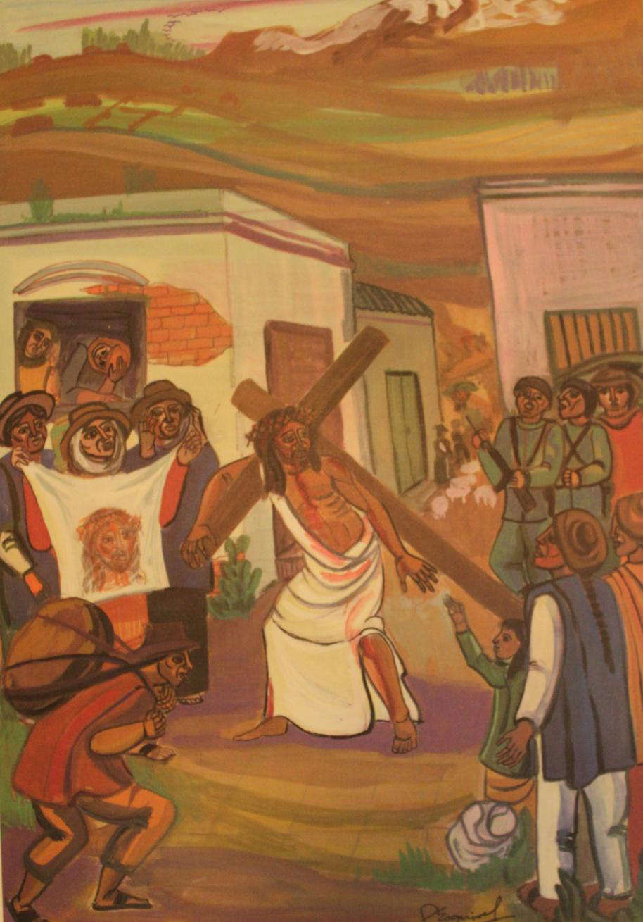
Lord Jesus, you told your disciples that they would see you, especially in the sick and suffering. We ask you to help us see your face in the faces of those who suffer. Like Veronica may we show great love and compassion to all whom we meet.

Slide 15
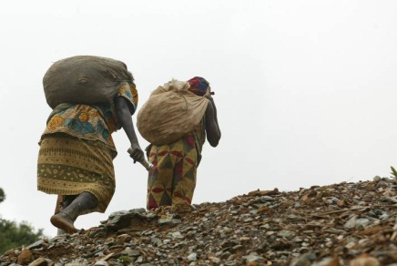
Seventh Station: Jesus falls for the second time.
Jesus has the heavy cross lying on his back. He is so tired and full of pain that he can’t carry it and he falls again. With Simon’s help he struggles to his feet and carries on.

Slide 16
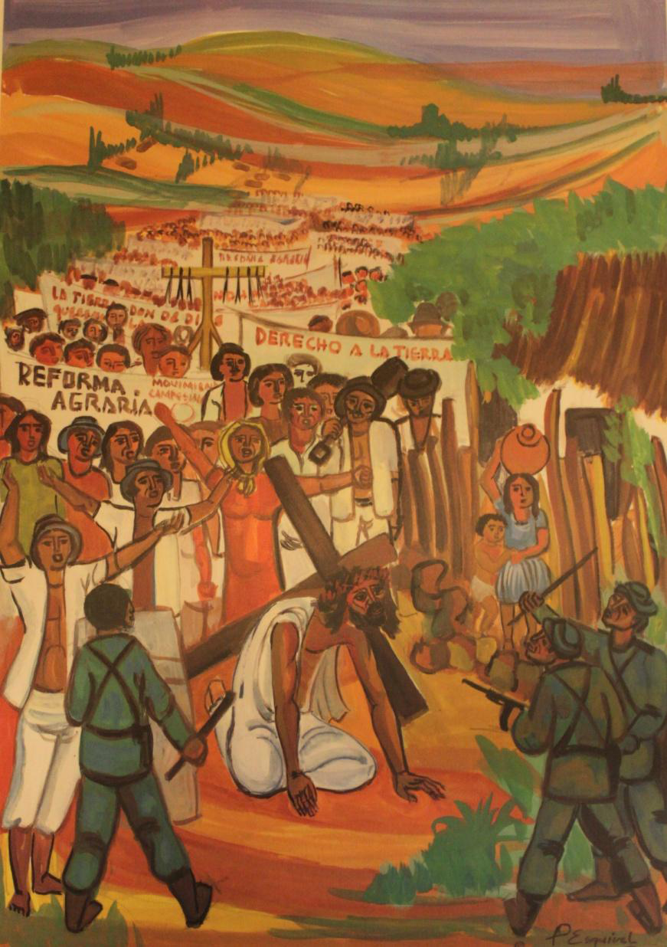
Lord Jesus, Sometimes it is difficult for us to carry on and complete things. We often want to give up. It is easier for us to take the easy option.
As we think of your painful struggle, we ask you to be with us when we struggle to do what is right.

Slide 17
Eighth Station: The women of Jerusalem weep for Jesus.
Not everybody is against Jesus, we see a group of women from Jerusalem crying. They didn’t want to see him suffer this way. Jesus is in a lot of pain, but he stops to talk to them. He tells them not to cry for him, but to cry for themselves and their children.

Slide 18
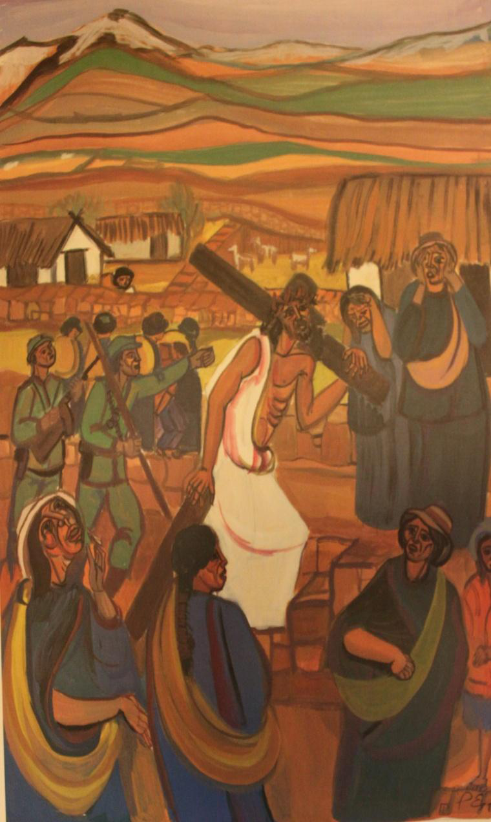
Lord Jesus, be with all those who mourn and are saddened because somebody they love has died.

Slide 19
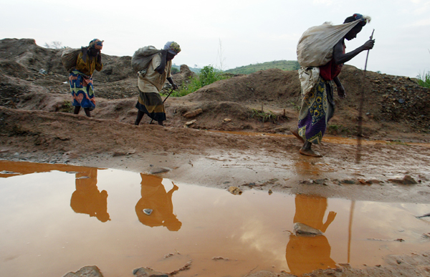
Ninth Station: Jesus falls for the third time.
Jesus has had enough. Thankfully he is almost at the place where they are going to crucify him. Yet, he can’t get there without falling again.

Slide 20
We ask you Lord Jesus to remain with all those who are in great pain, especially those who are close to death.

Slide 21
Tenth Station: Jesus is stripped of his garments.
This was a very painful moment for Jesus. His body was covered with bruises and he had also been beaten with a whip.
It was a very cruel thing to do. Today, people still do cruel things that hurt other people.

Slide 22
Let us think about what we can do to make sure that we are not cruel to others…..
Lord in your mercy, hear our prayer.

Slide 23
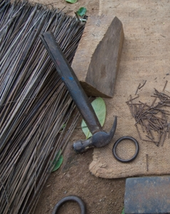
Eleventh Station: Jesus is nailed to the cross.
Jesus arrives at Golgotha, where he is to be crucified. He is made to lie on the cross while his wrists and feet are nailed to the cross. He must have been in terrible agony.

Slide 24
Lord Jesus, May I do all that I can to bring joy and not pain to others. If I ever have to suffer in my life, please be with me and lift me up with your strength.

Slide 25
Twelfth Station: Jesus dies on the cross.
This is the saddest moment in the life of Jesus. He hung on the cross for three hours. His disciples, mother and friends were there with him. Before he died he asked God, his Father to forgive those who had done this to him, because they didn’t really know what they were doing.

Slide 26
Lord, forgive the wrong that I have done, the pain I have caused by my failure to love. Lord have mercy

Slide 27
Thirteenth Station: Jesus is taken down from the cross.
After he had died, Jesus’ body was taken off the cross and placed in the arms of Mary his Mother. Imagine how she must have felt. The son she had loved and cared for was now dead.

Slide 28
This reminds us that it is important to look after people who are sad when somebody they love has died.
Lord we remember all those who have carried the cross in this life and now rest in your peace. Bring them to everlasting life.

Slide 29
Fourteenth Station: Jesus is placed in the tomb.
Joseph of Arimathea asked Pilate for the body of Jesus. He was a disciple of Jesus and wanted to bury Jesus’ body in a tomb. A huge stone is rolled in front of the tomb.

Slide 30
Lord Jesus, we thank you for your suffering and death. You offered your life back to the Father for us all. Teach us to thank you for all that you have done and to walk in your footsteps, even in the difficult moments of life.

Slide 31
Fifteenth Station: Jesus is risen from the dead.
Three days after all this happens, Jesus is found to be alive. His body has gone from the tomb, the stone has been rolled away. He appears to Mary Magdalene and some of the disciples.

Slide 32
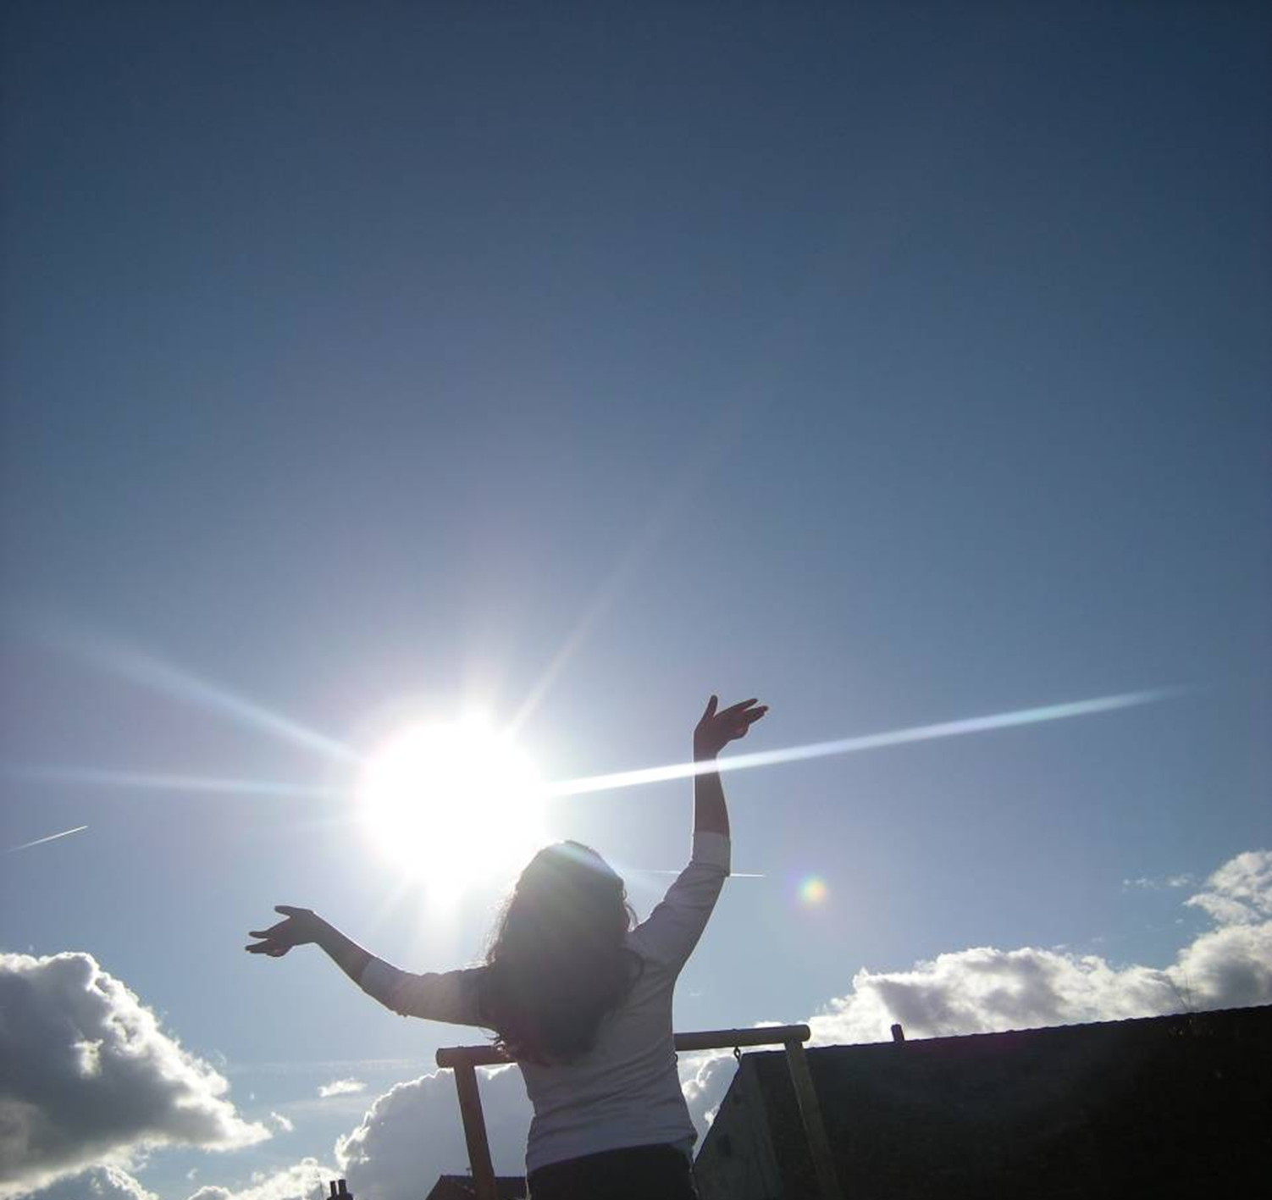
Father, thank you for raising Jesus to life. Help us to meet Jesus, and may we always be aware of his saving presence in our lives

Slide 33
Stations Of The Cross

